Slide 1
Dubizzle Motors Price Prediction
Insights and Impacts

Slide 2

Introduction
I'll take you on a thorough tour of my most recent Car price prediction analysis in my presentation today, which will be emphasized by the sophisticated use of Machine learning and Power BI reports. The core of my study is my dataset, which includes a broad range of Car characteristics, such as Brand name, Model name, engine specs etc.
I used Power BI to enhance this refined dataset and make my data more visually appealing. Thanks to Power BI's dynamic dashboards and interactive visualizations, which also helped me to identify patterns and trends that were not immediately obvious.

Slide 3
Contents of this Project
Leveraging various tools for Deeper Understanding.
MySQL | A potent tool for data processing and querying, It provided me some useful insight
Tableau | It helps me make the same unique graphs : Boxplot, pareto chart, KPIs
Power Bi | It helps me to create dynamic dashboards and interactive visualizations.
Pandas | This allows me to organize and clean up my data.
Machine Learning Algorithms | It assists me in forecasting new output values.
Predictions | ML helps me forecast future values.

Slide 4
Contents of Machine Learning
01
02
03
04
05
06
Data collections
Data preprocessings
Exploratory Data Analysis
Spliting Data
Select appropriate ML model
Make Predictions

Slide 5

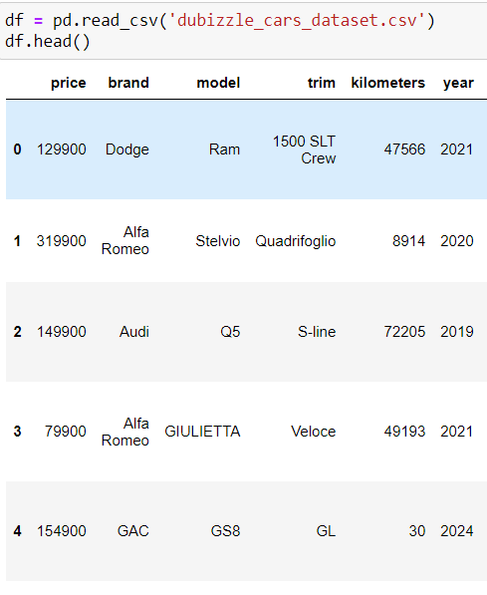

01
Data collections

Slide 6
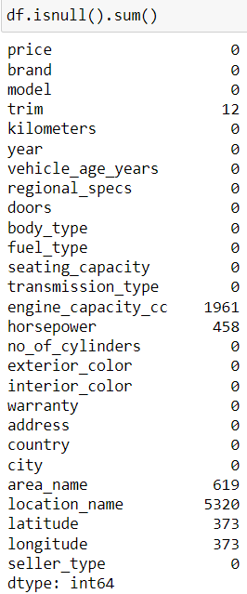
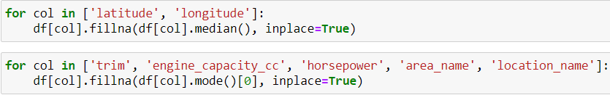
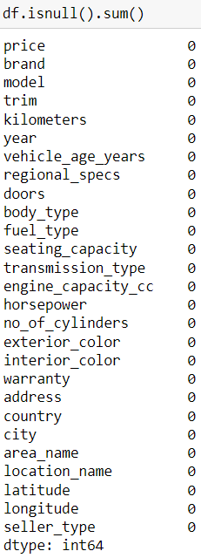
Data preprocessing :
02
In order to purge inconsistent data from the data and clean it up

Slide 7
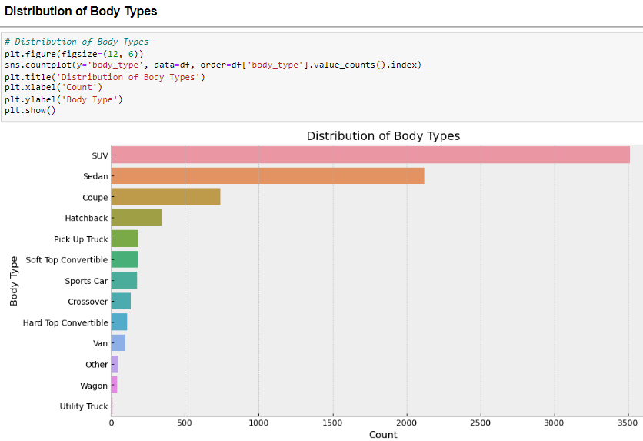
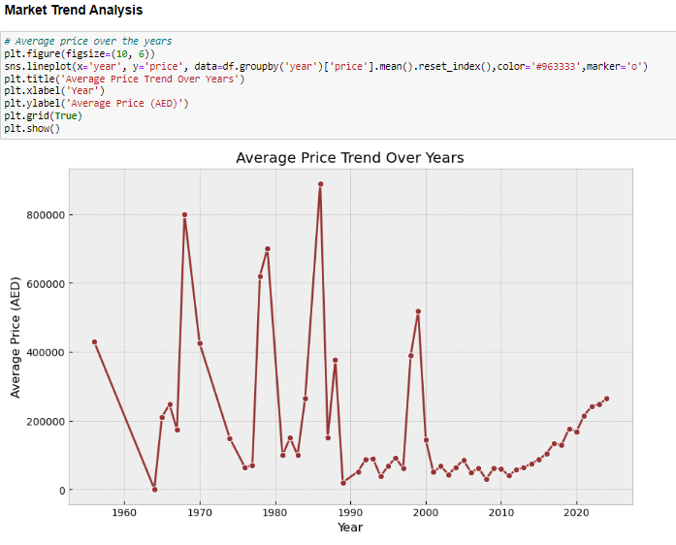
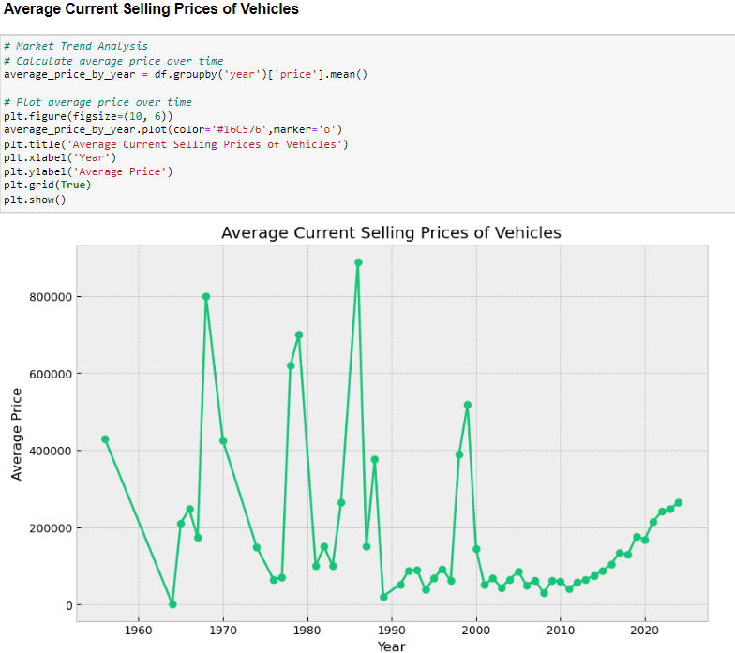
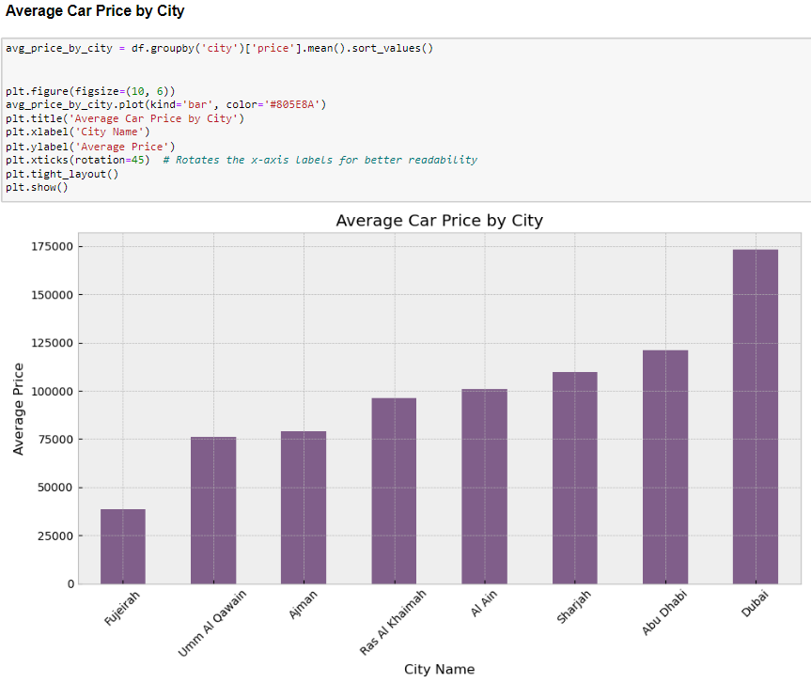
Exploratory Data Analysis
03

Slide 8
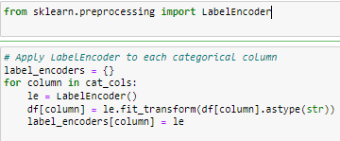
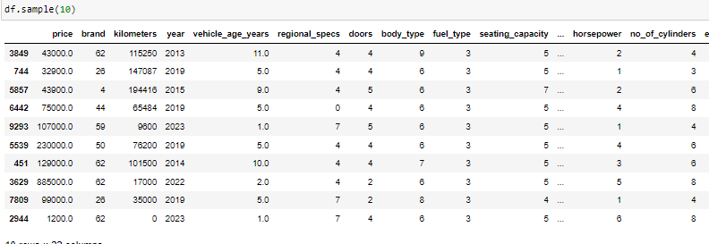
Encoding
Label Encoder in Action:

Slide 9
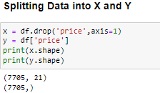
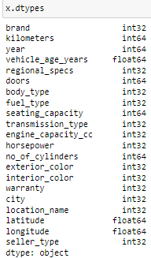
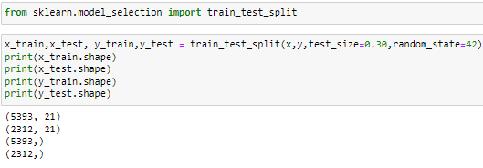
Splitting Data into X and Y:
04

Slide 10

Machine learning Algorithm:
05
OLS Models
Linear regression
Ridge
Lasso
Decision Tree
Random Forest
KNN Regressor
Ada Boost Regression
XG Boost Regression

Slide 11
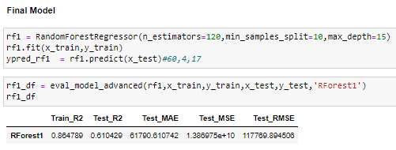
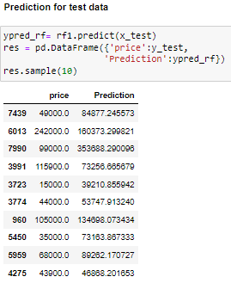
Prediction for test data:
06

Slide 12





Slide 13

Power Bi
Benefits of using Power Bi
User-Friendly: Power BI is easy to use with drag-and-drop features, making data visualization simple even for beginners.
Interactive Dashboards: Create dynamic and interactive dashboards that allow you to explore data by clicking on different elements.
Real-Time Data: Power BI can connect to real-time data sources, providing up-to-date insights.
4. Data Integration: It supports a wide range of data sources, enabling you to combine data from various platforms.
5. Powerful Analytics: With built-in DAX functions, Power BI allows for deep data analysis and custom calculations.

Slide 14
Power Bi Visualization roadmap
Initiative | Objective | Jan | Feb | Mar | Apr | May | Jun | Jul | Aug | Sep | Oct | Nov | Dec
Performance matrix | Use for KPIs
Sales Analysis | Sales insights
Pricing Analysis | Price distribution
Vehicle distribution Analysis | Various distribution of vehicles

Slide 15
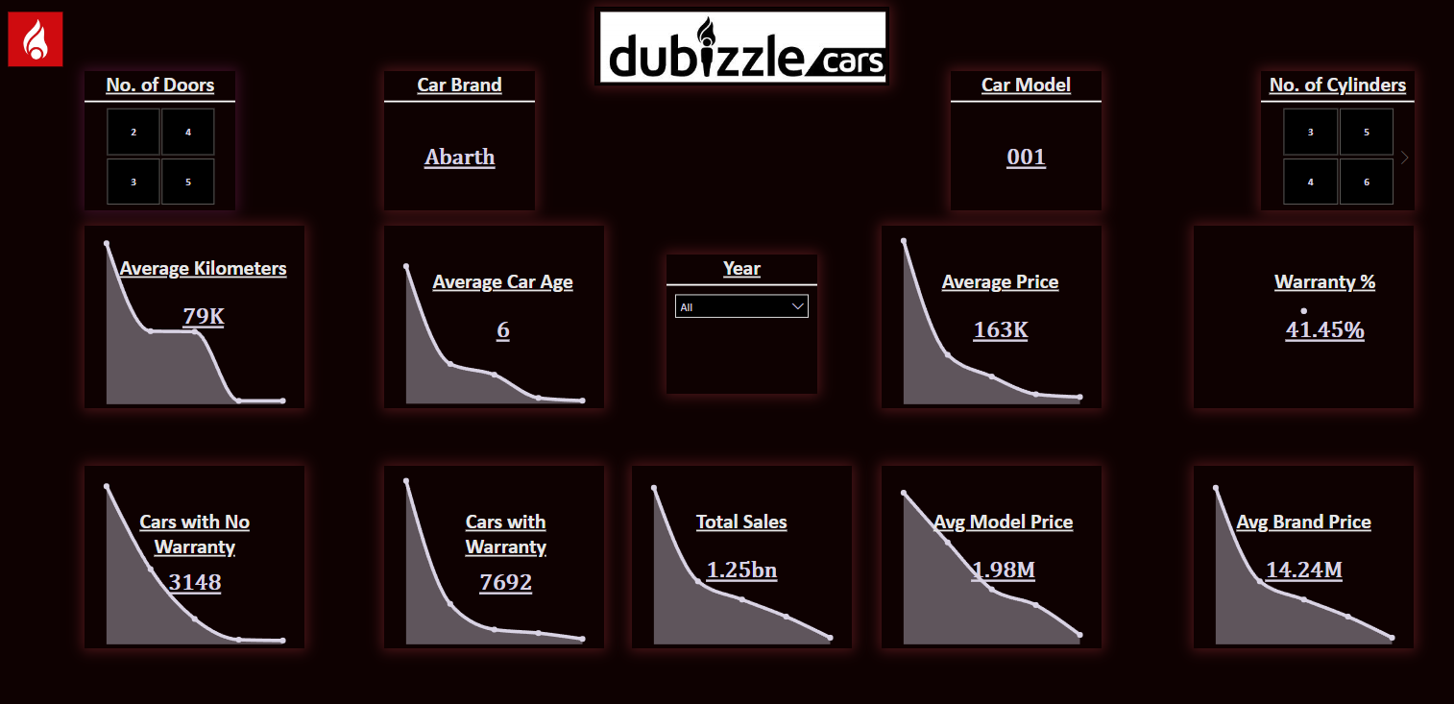

Slide 16
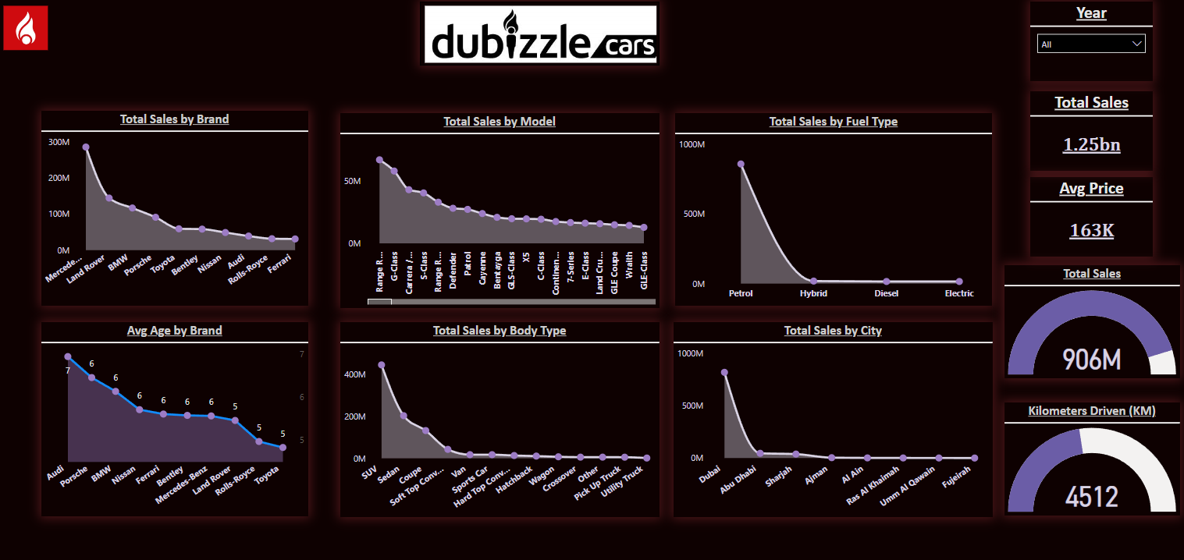

Slide 17
Thanks!

